Slide 1
Priorities + Scheduling and Scheduling Algorithm

Slide 2
Task Priorities
Each task is assigned a priority from 0 to ( configMAX_PRIORITIES - 1 ), where configMAX_PRIORITIES is defined within FreeRTOSConfig.h.
The maximum value to which configMAX_PRIORITIES can be set depends on the method used:
Generic Method : will be used if configUSE_PORT_OPTIMISED_TASK_SELECTION is set to 0 in FreeRTOSConfig.h
or if configUSE_PORT_OPTIMISED_TASK_SELECTION is left undefined, or if generic method is the only method
provided for the FreeRTOS port in use.
Architecture Optimized Method : will be used ifconfigUSE_PORT_OPTIMISED_TASK_SELECTION is set to 1 in
FreeRTOSConfig.h

Slide 3
Use the Task Priorities
If Generic Method is used FreeRTOS does not limit the maximum value to which configMAX_PRIORITIES can be set
If The Architecture Optimized method is used then configMAX_PRIORITIES cannot be greater than 32
However, it is always advisable to keep the configMAX_PRIORITIES value at the minimum necessary
Low priority numbers denote low priority tasks. The idle task has priority zero (tskIDLE_PRIORITY).
Any number of tasks can share the same priority. If configUSE_TIME_SLICING is not defined, or if configUSE_TIME_SLICING is set to 1, then Ready state tasks of equal priority will share the available processing time using a time sliced round robin scheduling scheme

Slide 4
Changing the Priority of a Task
void vTaskPrioritySet( TaskHandle_t pxTask, UBaseType_t uxNewPriority );
pxTask : Task được sửa đổi mức Priority. Một Task đang thực thi có thể thay đổi mức
Priority của chính nó bằng cách điền giá trị NULL vào tham số px Task.
uxNewPriority : Giá trị Priority cần set.
UBaseType_t uxTaskPriorityGet( TaskHandle_t pxTask );
pxTask : Task cần lấy ra mức Priority , Một Task đang thực thi có thể lấy ra mức Priority của
chính nó bằng cách điền giá trị NULL vào tham số pxTask.
Return value : Trả về Priority của pxTask.

Slide 5
Scheduling and
Scheduling Algorithm
What does Scheduling mean?
2. Scheduling Algorithm

Slide 6
What does Scheduling mean?
Throughput, or how fast it can finish a certain number of tasks from beginning to end per unit of time
Latency, which is the turnaround time or the time it takes to finish the task from the time of request or submission until finish, which includes the waiting time before it could be served
Response time, which is the time it takes for the process or request to be served, in short the waiting time
Types of scheduling include:
First come, first served — The most straightforward approach and may be referred to as first in, first out; it simply does what the name suggests.
Round robin — Also known as time slicing, since each task is given a certain amount of time to use resources. This is still on a first-come-first-served basis.
Shortest remaining time first — The task which needs the least amount of time to finish is given priority.
Priority — Tasks are assigned priorities and are served depending on that priority. This can lead to the starvation of the least important tasks as they are always preempted by more important ones.
Scheduling is a method that is used to distribute valuable computing resources, usually processor time, bandwidth and memory, to the various processes, threads, data flows and applications that need them. Scheduling is done to balance the load on the system and ensure equal distribution of resources and give some prioritization according to set rules. This ensures that a computer system is able to serve all requests and achieve a certain quality of service.
Scheduling is also known as process scheduling.
Scheduling in a system is done by the aptly named scheduler, which is mainly concerned with three things:

Slide 7
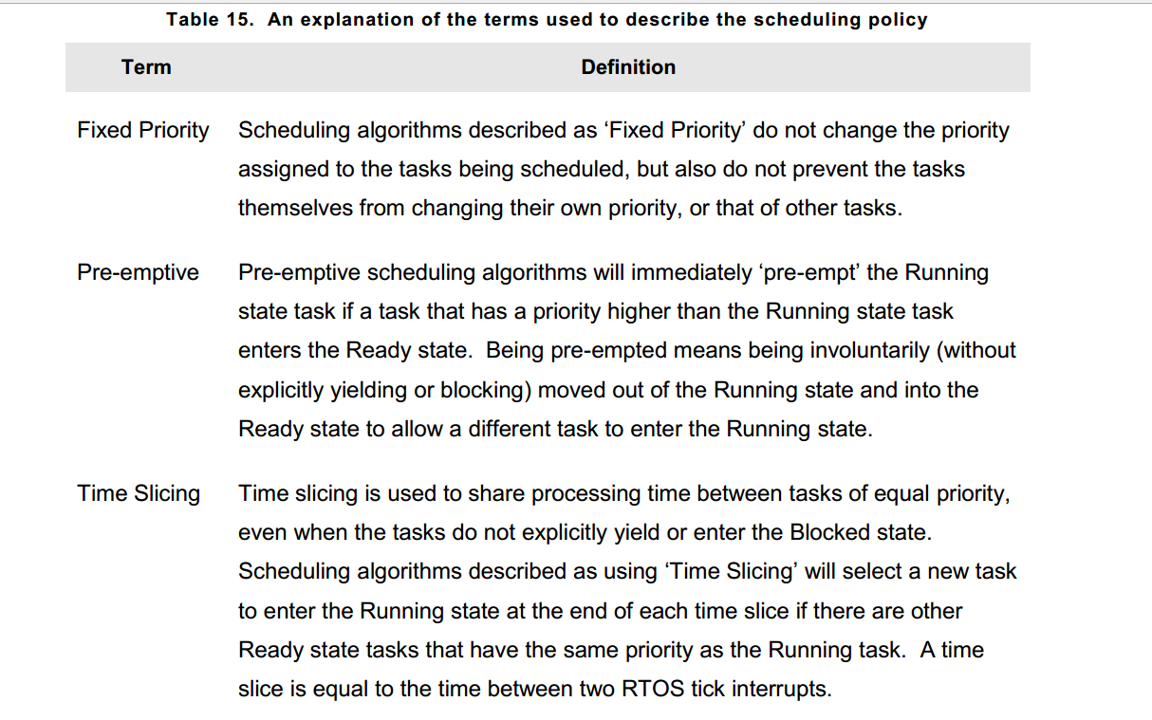
Scheduling Algorithm

Slide 8
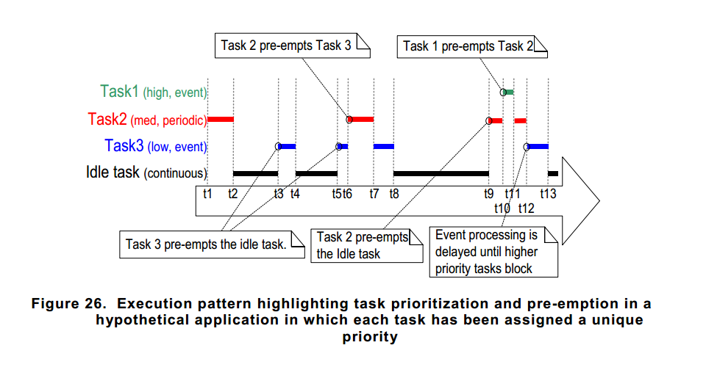
Scheduling Algorithm
Prioritized Pre-emptive Scheduling with
Time Slicing
Config :
configUSE_PREEMPTION 1
configUSE_TIME_SLICING 1
How it works ?

Slide 9
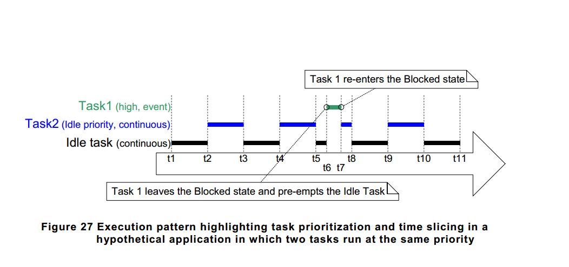
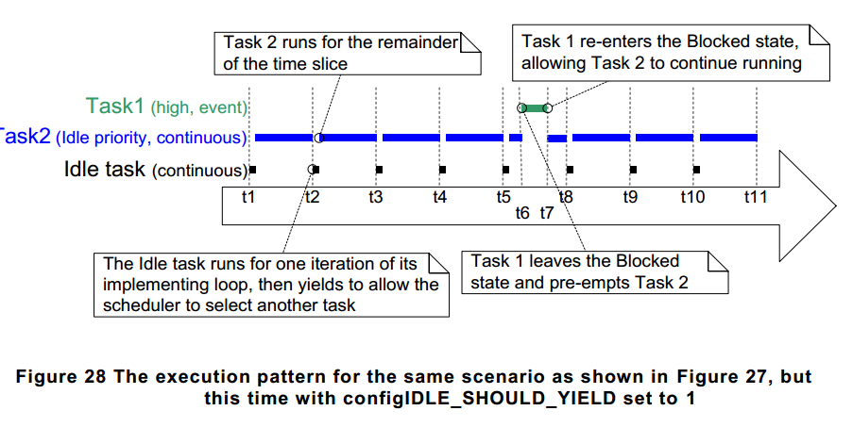
Prioritized Pre-emptive Scheduling with Time Slicing
If configIDLE_SHOULD_YIELD is set to 0 then the Idle task will remain in the Running state for the entirety of its time slice, unless it is preempted by a higher priority task.
If configIDLE_SHOULD_YIELD is set to 1 then the Idle task will yield (voluntarily give up whatever remains of its allocated time slice) on each iteration of its loop if there are other Idle priority tasks in the Ready state.

Slide 10
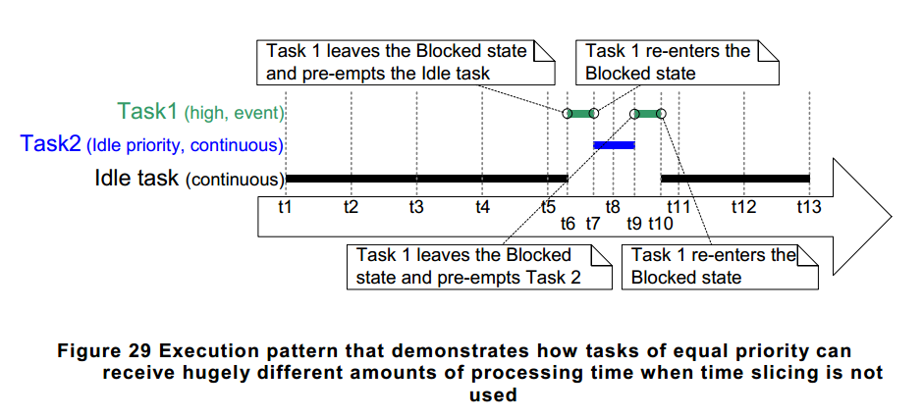
Scheduling Algorithm
Prioritized Pre-emptive Scheduling (without Time Slicing)
Config :
configUSE_PREEMPTION 1
configUSE_TIME_SLICING 0
How it works ?
A higher priority task enters the Ready state.
The task in the Running state enters the Blocked or Suspended state.

Slide 11
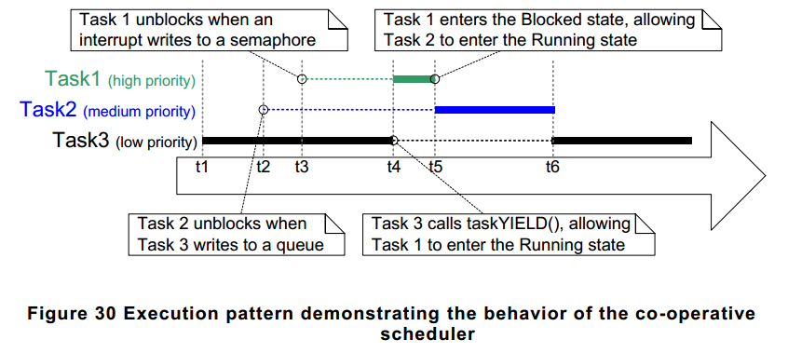
Scheduling Algorithm
3. Co-operative Scheduling
Config :
configUSE_PREEMPTION 0
configUSE_TIME_SLICING Any value
How it works ?

Slide 12
Thanks for listening

